Slide 1
DEPLOYMENT, BRANCHING, CI/CD
M Yousuf Bin Azhar
Software Engineering

Slide 2
CHANGING LANDSCAPE OF DEPLOYMENTS
Shift towards frequent deployments - Windows updates, Tesla OTA updates, Whatsapp, outlook.com
Benefits of shorter deployment cycles
Time-to-market is reduced
Customers get product value in less time
Customer feedback also flows back into the product team faster
Overall developer morale goes up
Drawbacks
Reliability issues
Customer experience?

Slide 3
CHALLENGES OF MODERN APPLICATIONS
Distributed or cloud-based architecture
Elastic scalability and resilience
Microservices complexity
Abstraction of the infrastructure layer

Slide 4

DEVOPS
Combination of cultural philosophies, practices, and tools that increases your ability to deliver applications and services at high velocity
Development and operations teams are no longer “siloed.”
Benefits
Speed (microservices, continuous delivery) – innovate, adapt
Rapid delivery (CI/CD)
Reliability (monitoring and logging)
Scale (infrastructure as code)
Collaboration (dev <> operations)
Security (Policy as code)
https://aws.amazon.com/devops/what-is-devops/

Slide 5
POPULAR DEPLOYMENT STRATEGIES
Big Bang Deployment
Rolling Deployment
Blue-Green Deployment
Canary Deployment

Slide 6
BIG BANG DEPLOYMENT
Deploy the whole system or large part in one go – DVD, CD, floppy, full download
All major pieces packaged in one deployment;
Largely or completely replacing an existing software version with a new one;
Deployment usually resulting in long development and testing cycles;
Assuming a minimal chance of failure as rollbacks may be impossible or impractical;
Completion times are usually long and can take multiple teams’ efforts;
Requiring action from clients to update the client-side installation.
Less agile
Outages

Slide 7
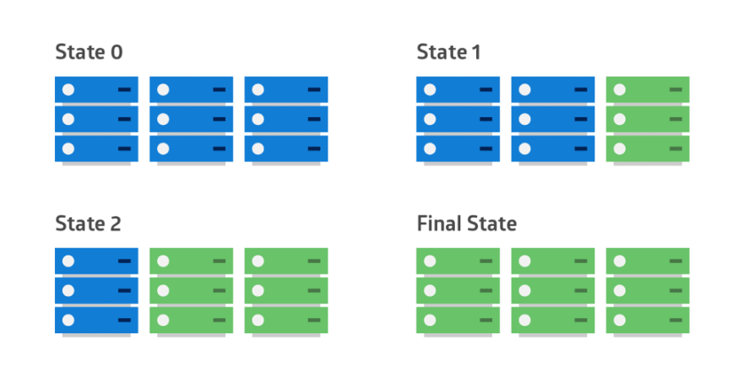
ROLLING DEPLOYMENT
Gradual deployment process
Mitigation of risks and downtime
Example scenarios (e.g., application suite upgrade)
Easy to rollback
E.g., Office 365

Slide 8
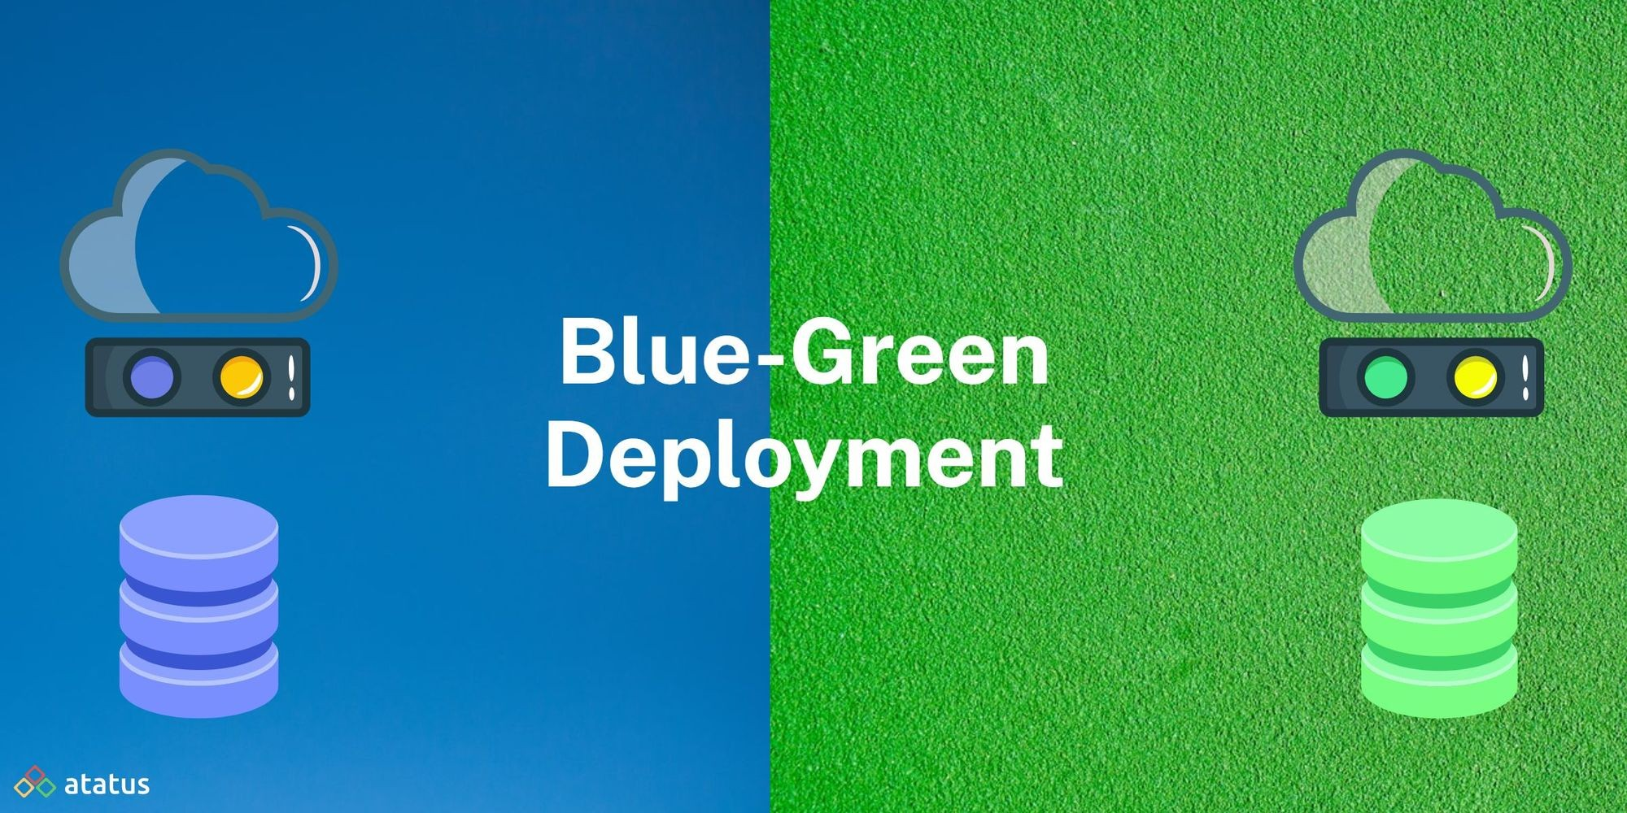
BLUE-GREEN DEPLOYMENT
Setup with parallel environments
New version of the application is deployed in the green environment and
tested for functionality and performance.
After successful testing, application traffic is routed from blue to green.
Green then becomes the new production.
Common / synced data stores

Slide 9
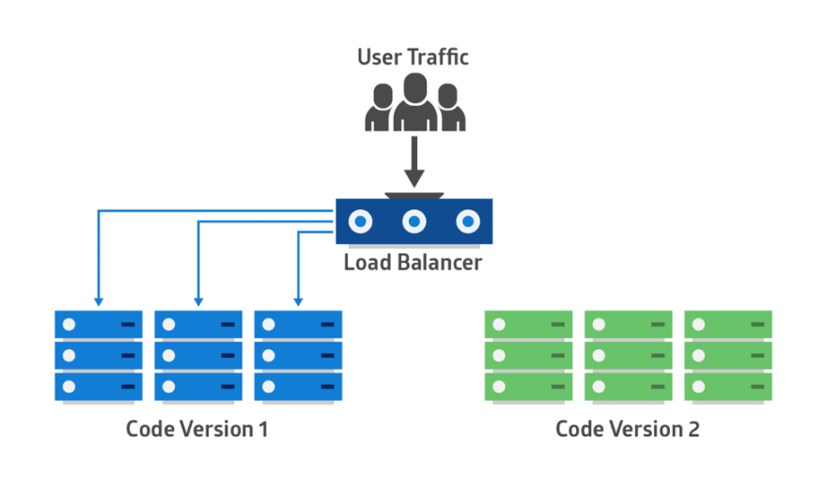
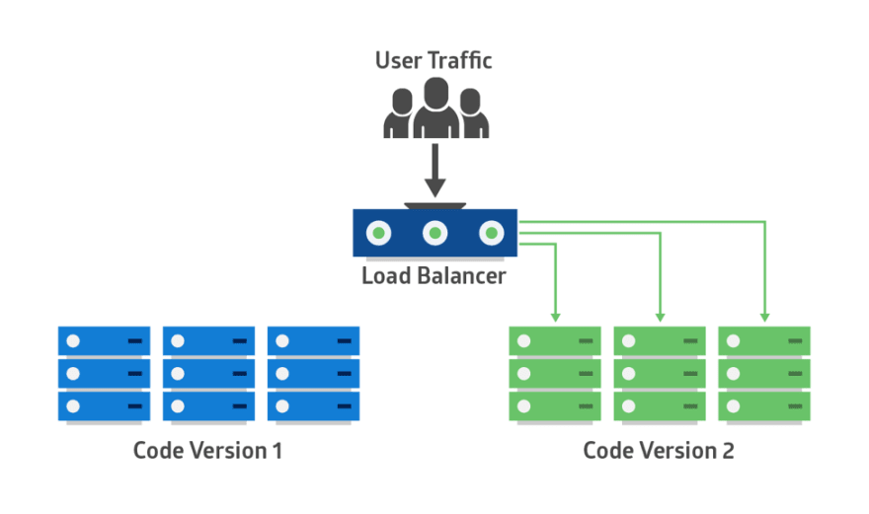

Slide 10
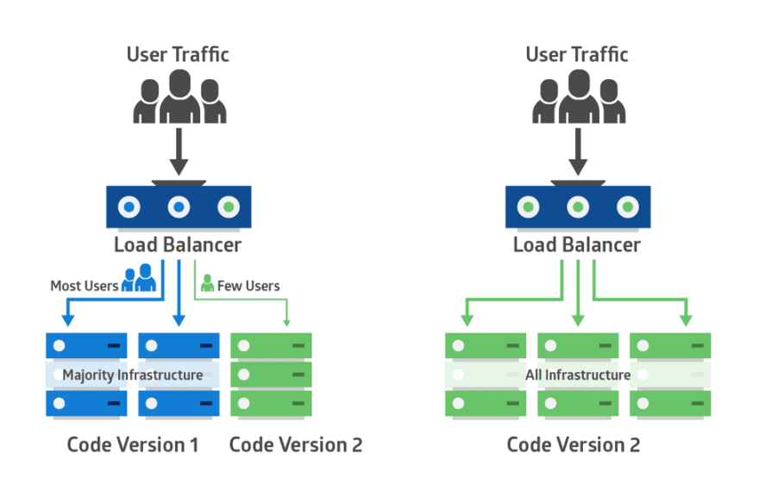
CANARY DEPLOYMENT
Phased deployment approach
Like blue-green but more risk-averse.
Deploy a new application code in a small part of the production infrastructure.
Once the application is signed off for release, only a few users are routed to it.
New version can gradually roll out to the rest of the infrastructure.

Slide 11
FEATURE TOGGLE DEPLOYMENT
Feature toggles (or feature flags) involve deploying new features as "hidden" or disabled.
Configuration switches enable selective feature activation.
This way, teams can control feature releases to specific user groups, perform A/B testing, or quickly disable a feature if issues arise.

Slide 12
A/B TESTING DEPLOYMENT
New version alongside the older version in A/B testing deployment.
New version is only available to a limited number of users
After gathering statistics from performance monitoring, developers deploy the version of the application that yielded the best results.
A/B testing is difficult to set up and requires a high-end load balancer.

Slide 13
DEPLOYMENT BEST PRACTICES
Deployment checklist
Continuous Integration (CI)
Continuous Delivery (CD)
Standard Operating Environments (SOEs)
Build Automation tools for build environments
Configuration Management?
Communication Channels for build notification
Automated Rollbacks

Slide 14
POST-DEPLOYMENT MONITORING
Importance of monitoring
Application Performance Monitoring (APM)
Error Monitoring with tools like Rollbar, error logging in code
Shared visibility among teams
Collaboration and responsiveness

Slide 15
Version Control
Git
SVN
TFS
VSS

Slide 16
GIT
https://learngitbranching.js.org
Secure storage / Backup
Versioning
Collaboration
Roadmap / feature development

Slide 17
COMMON OPERATIONS
Clone
Pull
Commit
Push
Merge

Slide 18
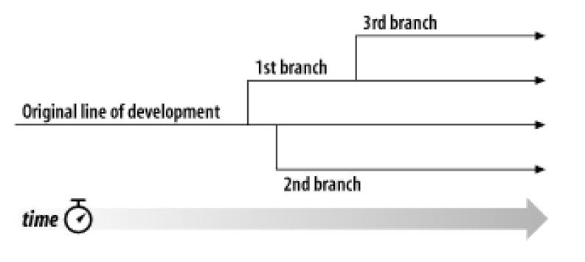
MAIN / BRANCH / TAG
main / master–Current release code – only! The trunk should always be stable and compile-able.
Tags – Used to provide a snapshot of the code at a specific point in your project’s history
Branches – For working on significant changes, variations of code etc, without disrupting the stable code in the main / master.

Slide 19
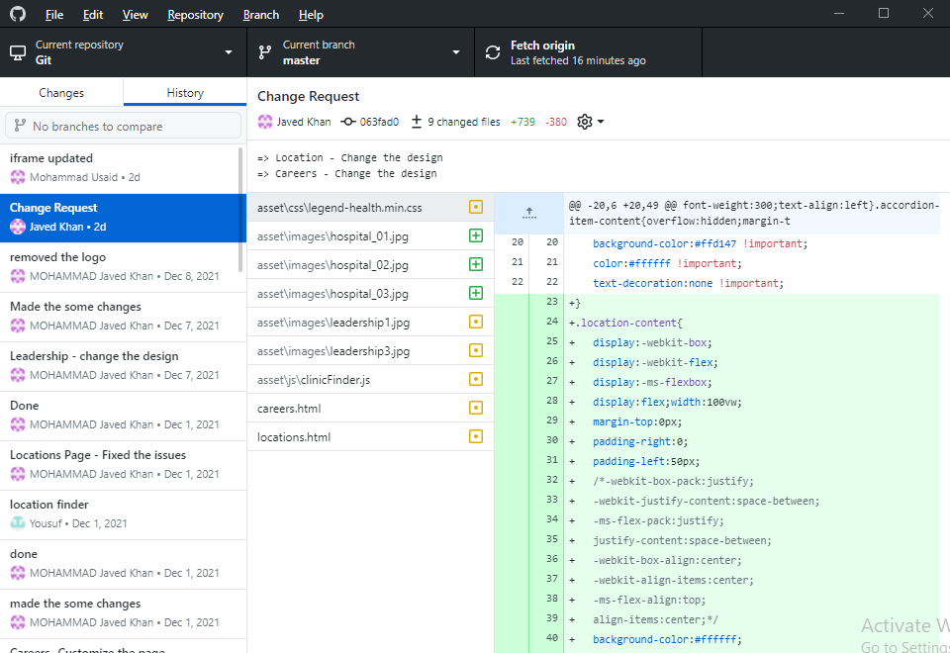
HISTORY
For both folders and files

Slide 20
FILE DIFF TOOL

Slide 21
WHAT IS BRANCH?
The basic concept of a branch — a line of development that exists independently of another line, yet still shares a common history if you look far enough back in time.
A branch always begins life as a copy of something, and moves on from there, generating its own history

Slide 22
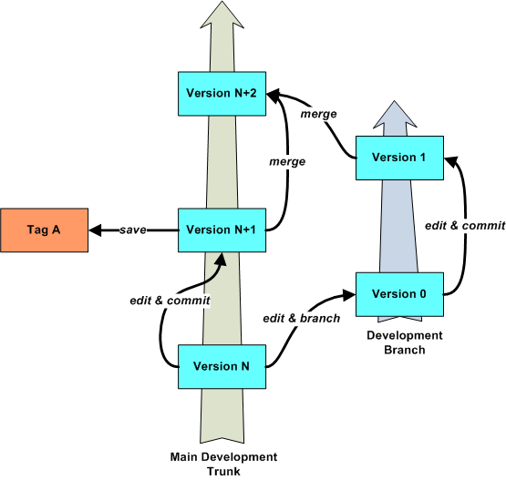
MERGE
Merge – the general act of replicating changes from one branch to another is called merging
Must deal with conflicts

Slide 23
Branching Strategies
Decide based on your team organization, culture and project requirements

Slide 24

Trunk-Based Development
Emphasizes frequent integration and testing on the main branch to ensure a high level of collaboration and continuous delivery.
https://tilburgsciencehub.com/topics/automation/version-control/advanced-git/git-branching-strategies/

Slide 25
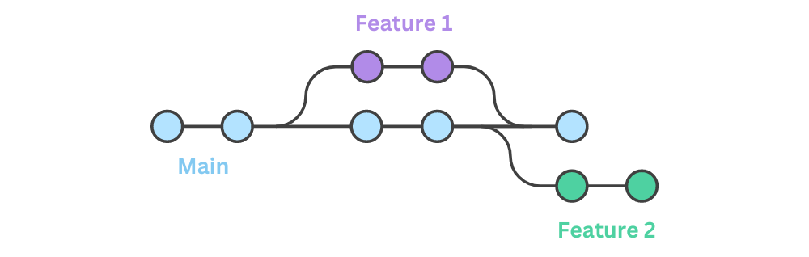
Feature Branching
Involves creating separate branches for individual features or changes to allow for isolation, testing, and review before merging into the main branch.
https://tilburgsciencehub.com/topics/automation/version-control/advanced-git/git-branching-strategies/

Slide 26
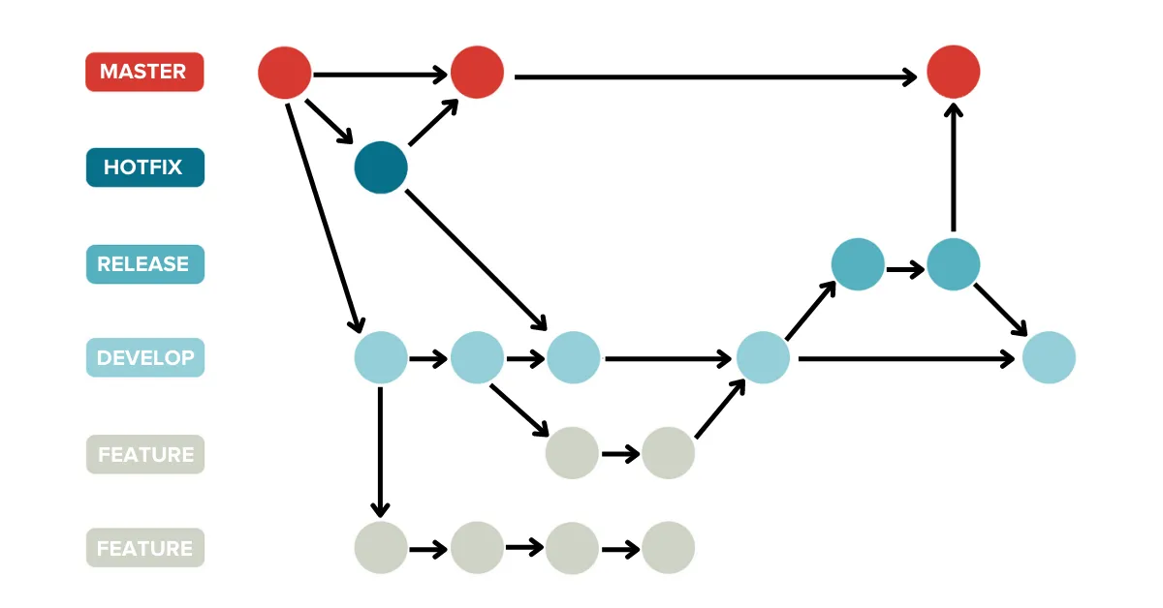
Git Flow
Builds on Feature Branching by adding additional branches for managing releases and hotfixes, providing a structured approach for managing different types of changes in larger teams or more complex projects.

Slide 27
ADVANCED TOPICS
Ignore
Rebase
Tagging
Conflict resolution
Stash
Reset
Squash
Bisect
Cherry pick
Revert

Slide 28
CI/CD
CI/CD falls under DevOps
CI/CD automates much or all of:
Build
Test (including integration tests, unit tests, and regression tests)
Deploy phases
Infrastructure provisioning

Slide 29
Continuous Integration (CI)
Continuous integration
Integrating all code changes into a designated branch early and often
Automatically testing each change upon commit or merge
Automatically kicking off a build
Benefits of continuous integration
Minimizing code conflicts
Facilitating quick bug fixes and security issue resolution
Code validation
Static code analysis for code quality verification
Automated packaging and compilation for further testing
Relies on version control system to track code changes

Slide 30
Continuous Delivery (CD)
Continuous delivery
Automates infrastructure provisioning and application release process
Works alongside continuous integration (CI)
Final stages of CI/CD
Packages tested and built code for deployment
Ensures deployment readiness for any environment
Includes infrastructure provisioning
Benefits of continuous delivery
Software built for deployment at any time
Option for manual or automated deployments
You can transition to continuous deployment for fully automated deployments

Slide 31
CI/CD fundamentals
A single source repository The repository should contain everything needed for the build:
Source code
Database structure
Libraries
Properties files
Version control
Test scripts
Scripts to build applications
Frequent check-ins to main branch Integrate code in your trunk, mainline or master branch — i.e., trunk-based development
Avoid sub-branches and work with the main branch only.
Use small segments of code and merge them into the branch as frequently as possible.
Don't merge more than one change at a time.

Slide 32
CI/CD fundamentals
Automated builds
Scripts should include everything you need to build from a single command:
Web server files
Database scripts
Application software.
Self-testing builds
Continuous testing
Failure of a test results in a failed build.
Pre-build testing scripts to check code for integrity, quality, and security compliance.
Only allow code that passes static tests into the build.

Slide 33
CI/CD fundamentals
Frequent iterations
Multiple commits to the repository - fewer conflicts
Small, frequent iterations rather than major changes
Rollback is easier
Stable testing environments
Tested in a cloned version of the production environment.

Slide 34
CI/CD fundamentals
Maximum visibility
Information in the repository should be visible to all
Version control to manage handoffs so developers know which is the latest version.
Everyone can monitor progress and identify potential concerns
Predictable deployments anytime
Deployments should be so routine and low-risk that the team is comfortable doing them anytime.
CI/CD testing and verification processes should be rigorous and reliable.

Slide 35
Benefits of CI/CD implementation
Happier users and customers
Accelerated time-to-value
Less fire fighting
Hit dates more reliably
Free up developers' time
Less context switching
Reduce burnout
Recover faster

Slide 36
REFERENCES
https://www.plutora.com/blog/deployment-strategies-6-explained-in-depth
https://www.linkedin.com/pulse/different-types-deployments-software-development-kaveen-akash/
https://dev.to/mostlyjason/intro-to-deployment-strategies-blue-green-canary-and-more-3a3
https://about.gitlab.com/topics/ci-cd/

